Slide 1
Object Oriented Software Development (C++) OOP345
Madiha Kazmi

Slide 2
Assessment Summary
Workshops | 25% | Best 8 (@3.125% each) out of min. 9
Final Project | 15%
Quizzes | 15% | Best 8 (@1.875% each) out of min. 10
Test #1 | 15%
Test #2 | 30%

Slide 3
Week 10
Raw Pointers
01
Smart Pointers
02

Slide 4
Raw Pointers - Objective
Create program components using raw pointers and pointer arithmetic
This chapter reviews that part of the C++ memory model that describes the memory in the abstract machine through a review of raw pointer syntax.
The description covers C-style null-terminated character strings, which are part of the strings category of the Standard Library, and expressions that take pointer types as their operands.

Slide 5
Raw Pointers
“A memory model is an agreement between the machine architects and the compiler writers to ensure that most programmers do not have to think about the details of modern computer hardware." Stroustrup (2014)
Programming languages associate objects with memory locations in an abstract machine, letting programmers focus on changes to the values stored in those memory locations without regard to the locations in processor memory on the host computer.
A programming language's memory model defines how any compiler should relate the memory locations in the abstract machine to the physical memory locations in any processor.
The simplest memory model is an address space consisting of a contiguous sequence of bytes, with each address referring to its own byte. Such a model supports direct access to the underlying processor memory.

Slide 6
raw pointers in C++
In C++, a raw pointer is a built-in type that holds an address of a memory location in the abstract machine.
The pointer provides direct access to the object that occupies the region of memory that starts at that address.
Dereferencing the pointer accesses the value stored in the region of memory starting at the pointer's address.
The type systems of object-oriented languages associate regions of memory with objects. Each region associated with an object is a contiguous sequence of bytes.
Each object is stored at a unique address and the object's type determines the region of memory occupied by the object.

Slide 7
C-Style Character Strings
A C-style character string provides the simplest possible analogue for describing the memory that a raw pointer accesses.
These strings are arrays of byte-size elements.
The addresses of consecutive elements differ in value by one. That is, the memory is byte-addressable memory.

Slide 8
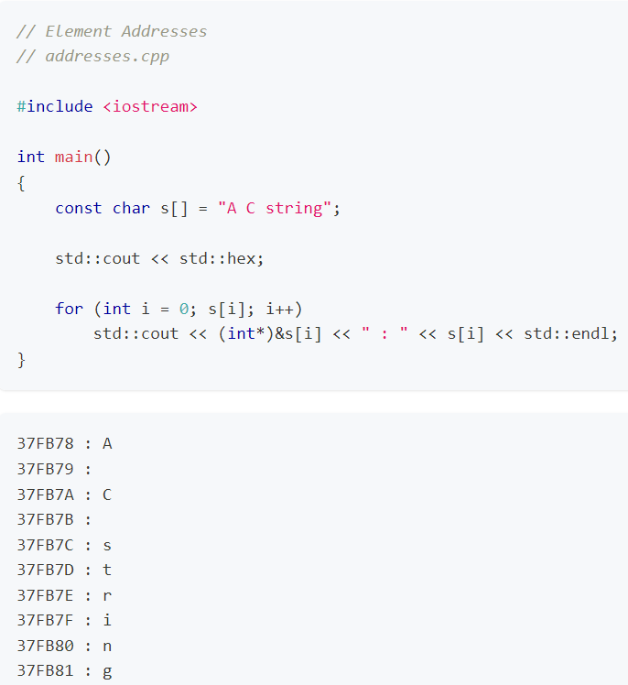
Element Addresses
The following program displays each character of a C-style character string along with its address in memory:

Slide 9
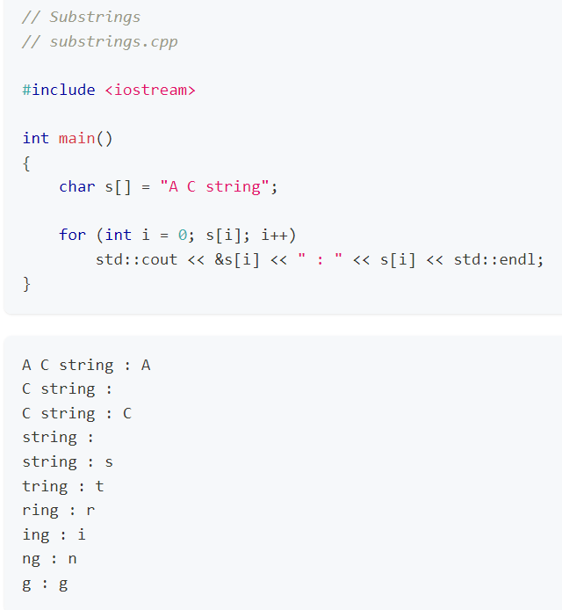
The std::hex manipulator specifies the current output format as hexadecimal. Note that in order to display the address of an element we cast it to an int* type. Without the int* cast, the substring starting at the address would display as shown below:

Slide 10
String Literals
​A sequence of characters surrounded by double quotes is called a string literal.
A string literal is an lvalue.
It is a primary expression stored in the segment of memory that holds global variables.
The lifetime of this segment is the lifetime of the program.
String literals have static duration.

Slide 11
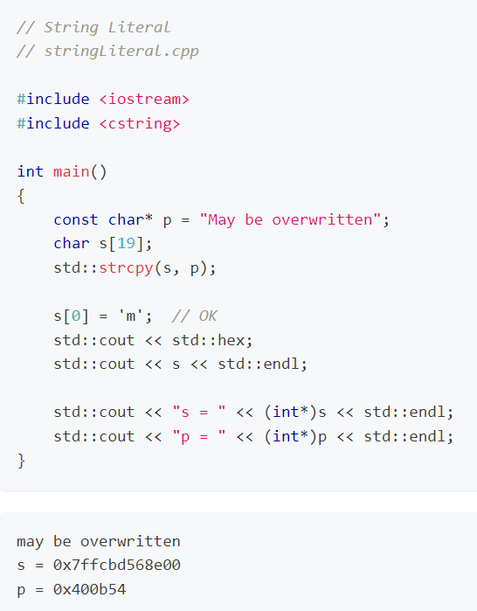
Copying a String Literal​
The following program defines a string literal, stores its address in a pointer, defines a C-style character string, copies the contents of the string literal into that second string, changes the first character to lower case and displays the updated string along with the addresses of the pointer and the string:
Note that the program does not alter the string literal itself. The memory for s is distinct from the memory for the string literal "May be overwritten", which we can change.

Slide 12
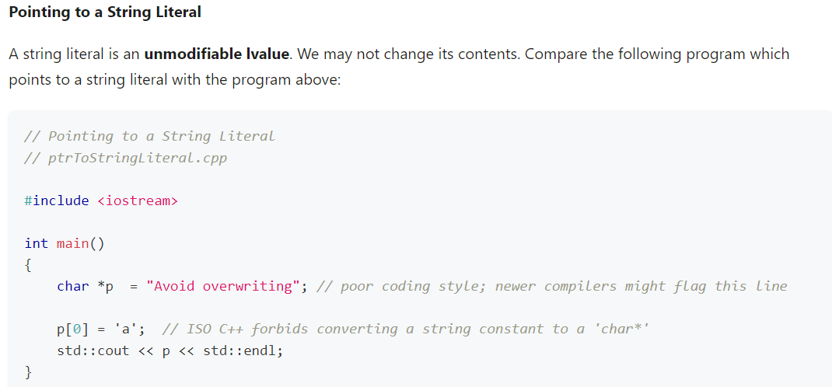
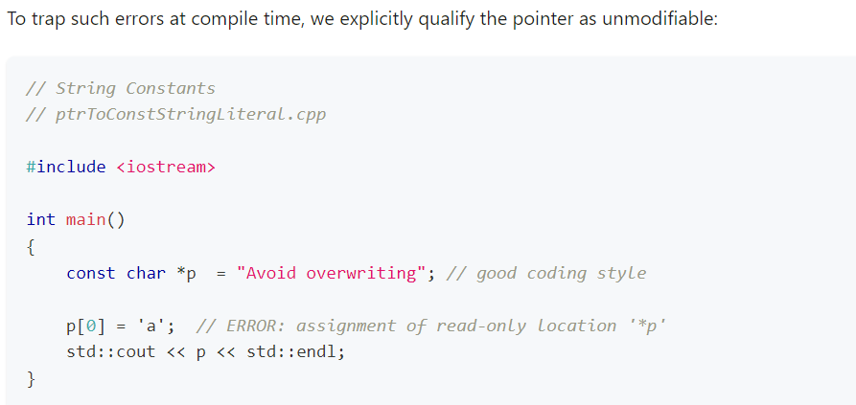

Slide 13
Arithmetic Operations
Addition​
A binary expression with the addition operator (+) adds the values of its operands. If one of the operands is of pointer type, the other must be of integral or unscoped enumeration type. The expression evaluates to the address that is the number of types beyond the address stored in the pointer operand. That is, the integral operand gives the offset in types (not bytes). For example,

Slide 14
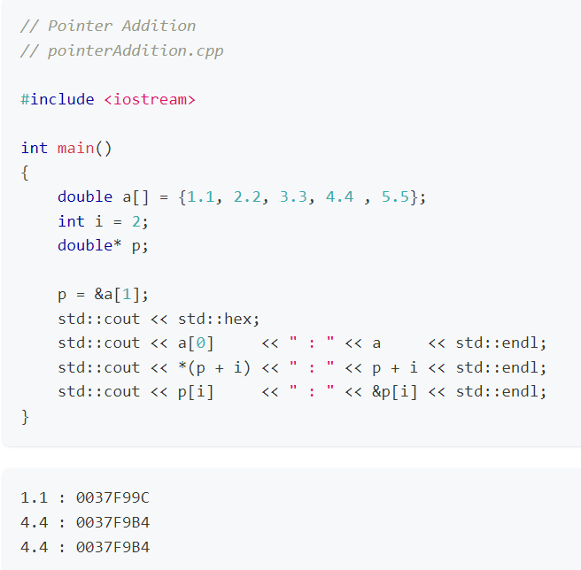
Addition​
Note that the difference between 0037F9B4 and 0037F99C is 18 hexadecimal or 24 decimal; that is, 3 doubles.
An addition expression with a pointer operand evaluates to a defined value as long as the result of the addition points to an element of the array or to the location that is one element beyond the end of the array. Otherwise, the expression is ill-defined.

Slide 15
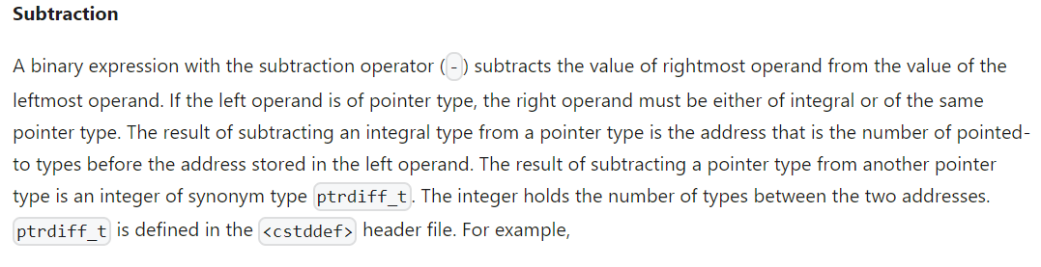
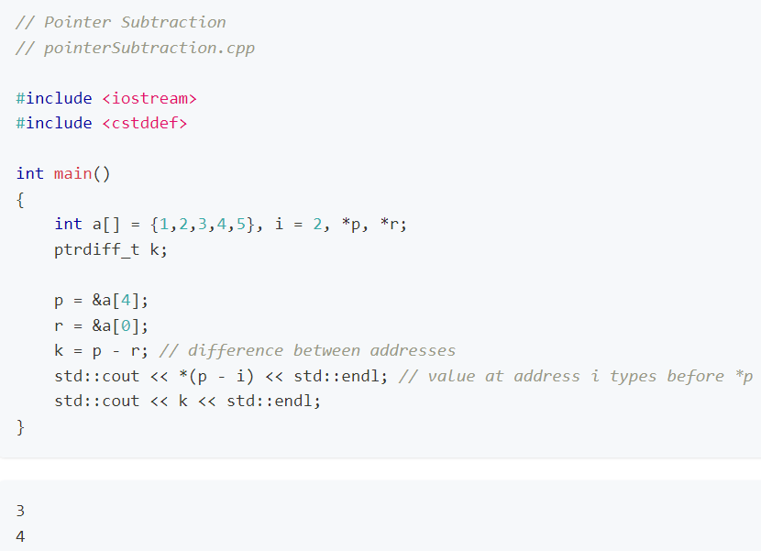
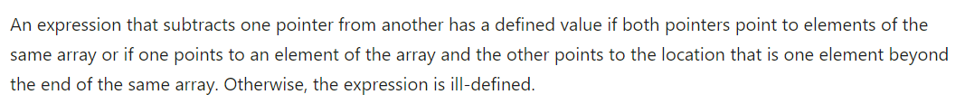

Slide 16
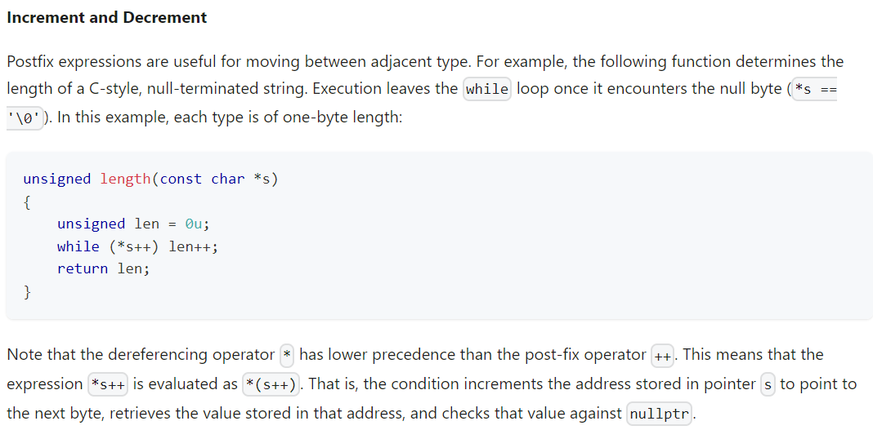
Postfix Operations

Slide 17
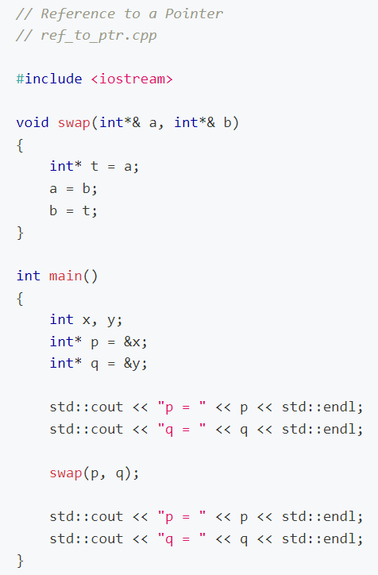
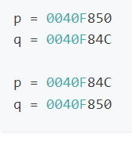
Reference to a Pointer
​A reference to a pointer lets us change the address that has been stored in a pointer outside a function from within the function in the same way that a reference to a variable that holds a value. For example,

Slide 18
exercise
Read Wikipedia on Pointers

Slide 19
Smart pointers-Objective
Create program components using smart pointers
This chapter reviews the exception handling case and describes two categories of smart ownership: exclusive and shared.

Slide 20
Smart Pointers
"Ensure resources are owned by objects. Use explicit RAII and smart pointers." Sutter, Alexandruscu (2005)
One of the principal uses of pointers in C++ applications is to identify resource variables.
In a narrow sense, a resource is an object that a program does not possess at load time but acquires and releases during run-time.
The most prominent example is memory on the heap (dynamically allocated memory). Other such resources include file handles, device interface objects and states of critical sections in multi-threaded applications.

Slide 21
Smart Pointers
In a broader sense, a resource is any object created and released in a program, including not only an object on the heap as well as one on the stack or in global scope
In this sense, the owner of a resource is an object or piece of code that is responsible for the resource's release.
Then, ownership falls into two distinct categories - automatic and explicit.

Slide 22
Smart Pointers- automatic ownership
An object is automatically owned if the mechanisms of the language guarantee its release.
For example, a C++ object that is composed of other objects guarantees their release at the time of its own release (Milewski, 2001).
Pointers (as well as handles and abstract states) require explicit management of the resources to which they refer.
For example, a pointer that holds the address of dynamically allocated memory retrieved using new requires the programmer to release that memory using delete.
In other words, in C++, a raw pointer, like a file handle or the state of a critical section, has no owner that would guarantee its eventual release (Milewski, 2001).

Slide 23
Smart pointers- explicit ownership
A smart pointer offers a mechanism that makes the explicit management of a resource automatic.
A smart pointer knows its resource. Unlike a raw pointer, a smart pointer, can manage the memory of the resource to which it points.
It is a proxy for a raw pointer to the resource and looks like and feels like a raw pointer. It supports the dereferencing (*) and indirect member selection (->) operators.
A smart pointer resides on the stack. When it goes out of scope, its destructor deallocates the dynamic memory to which it points or, in the case of a file handle, flushes the stream buffer and closes the stream.

Slide 24
Smart Pointers
Smart pointers implement the Resource Acquisition Is Initialization (RAII) idiom of object-oriented languages.
This idiom states that the acquisition of the resource occurs at initialization time; that is, at the same time as the memory for the pointer is created.
The need for smart pointers was in part motivated by the introduction of exception handling into the C++ language.
The C++ standard library now provides several implementations of smart ownership.

Slide 25
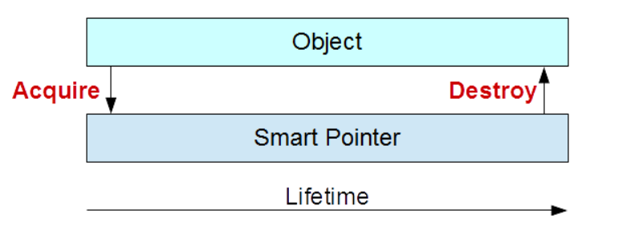

Slide 26
Exception Handling​
Throwing an exception can precipitate a memory leak.

Slide 27
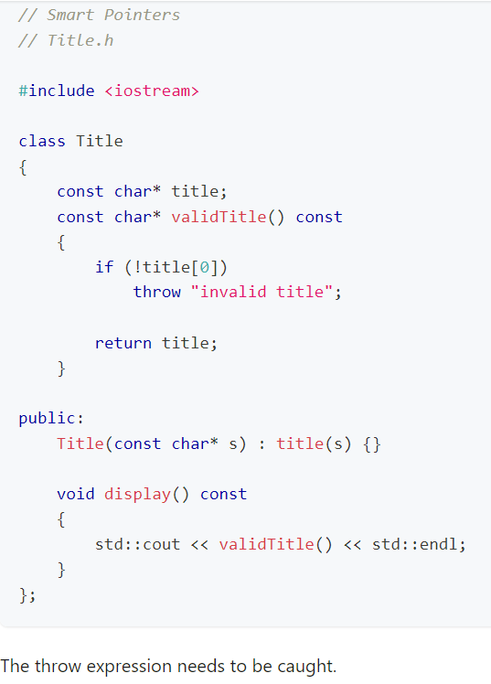
A Raw Pointer Case Study
​Consider the following class that includes a check on the validity of a person's title.
The Title class holds the title (Mr., Ms., Dr.) in a C-style null-terminated string.
The private validTitle() member function returns the address of a validated title. If the string is empty, this function throws an exception.
The public display() query calls this private member function to report a validated title string:

Slide 28
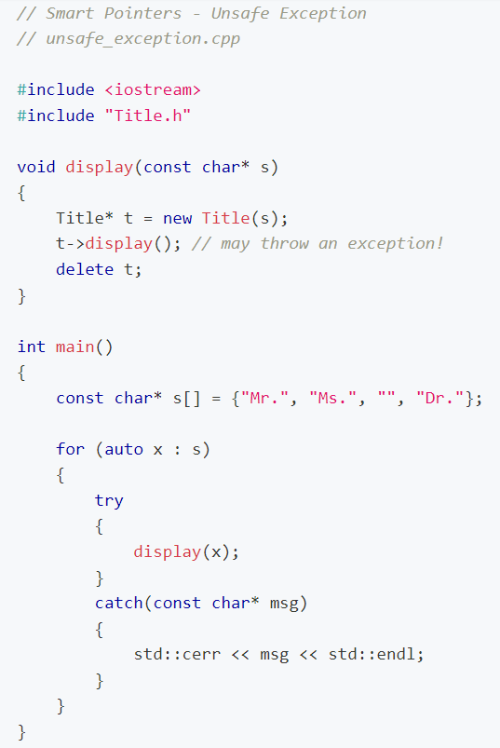
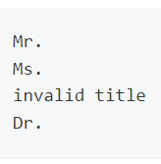
The Memory Leak
​Consider the following application that uses an object of the Title.
The display() function allocates dynamic memory for a Title object, calls the display() function on that object, and deallocates the memory for the object t.
Note that the private member function validTitle() called by member function display() may throw an exception and the global display() function does not catch any exception:

Slide 29
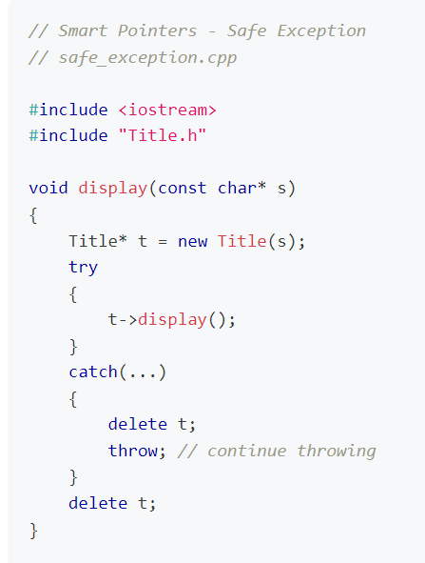
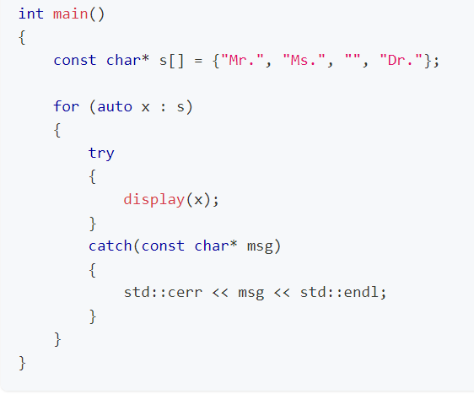
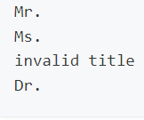
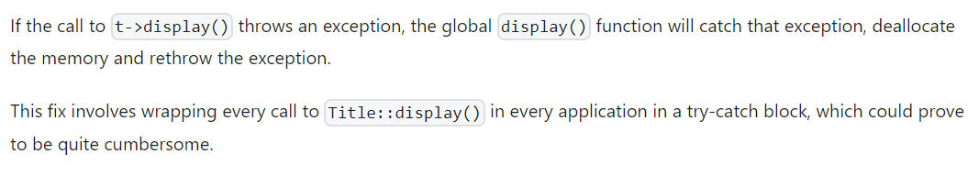
Fixing the Memory Leak​
We could fix the memory leak by wrapping the call to Title::display() in a try-catch block:

Slide 30
Taking Ownership of the Resource
​The alternative solution to the possibility of a memory leak is simply to take ownership of the resource itself. Such a solution replaces the wrapping of every call to Title::display() in a try ... catch block with a linkage of the lifetime of the Title object to the pointer to it.
We link these lifetimes together through smart pointer classes. A smart pointer class acquires ownership of the resource at the same time that it allocates memory for the pointer to the resource (that is, at construction time) and deallocates the memory for the resource at the same time as it deallocates memory for the pointer to that resource (that is, at destruction time).
Consider the following templated class definition. This definition wraps the code for a raw pointer to a resource within a class that manages that resource:

Slide 31
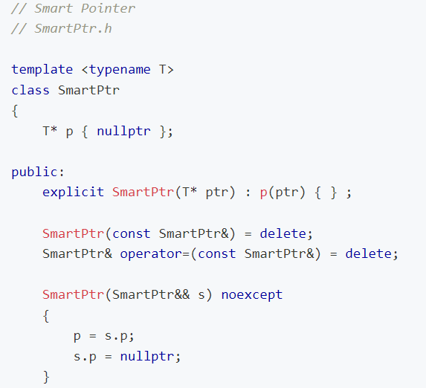
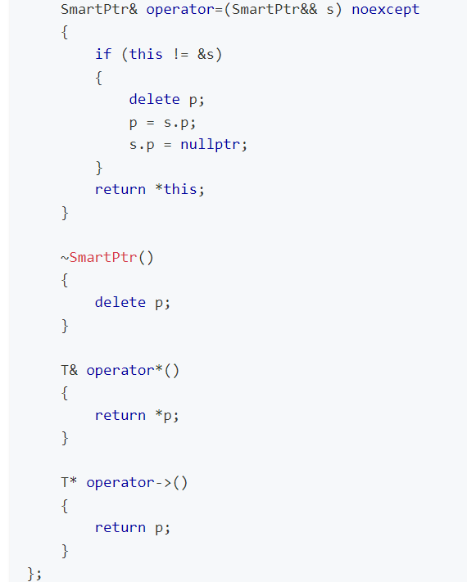

Slide 32
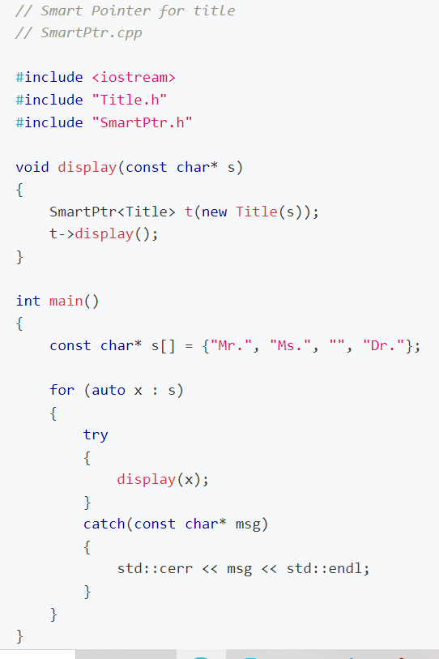
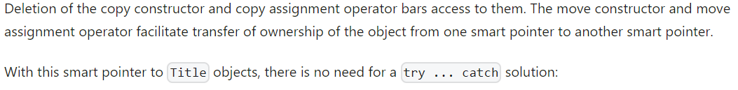
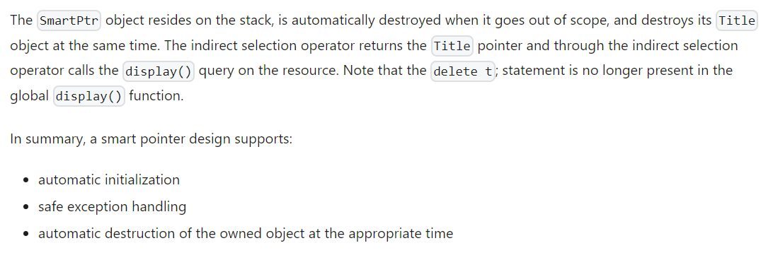

Slide 33
Exclusive Ownership​
The C++ Standard Library includes a smart pointer template for defining classes that manage one-to-one relationships between objects (or resources) and their pointers.
A unique smart pointer satisfies the following requirements:
provides exception safety for dynamically allocated memory
passes ownership of the object or resource on entering a function
passes ownership of the object or resource on returning from a function
collects the object or resource inside a container

Slide 34
Exclusive Ownership​
As ownership passes from one smart pointer to another, the host pointer detaches itself from the object or resource and reattaches the object or resource to the new pointer. This move process does not duplicate or destroy the object or resource. A unique smart pointer
owns its object or resource
stores a raw pointer to its object or resource
transfers ownership of the object or resource in move construction and move assignment
calls its object's or resource's destructor when it itself is destroyed
cannot copy construct or copy assign

Slide 35

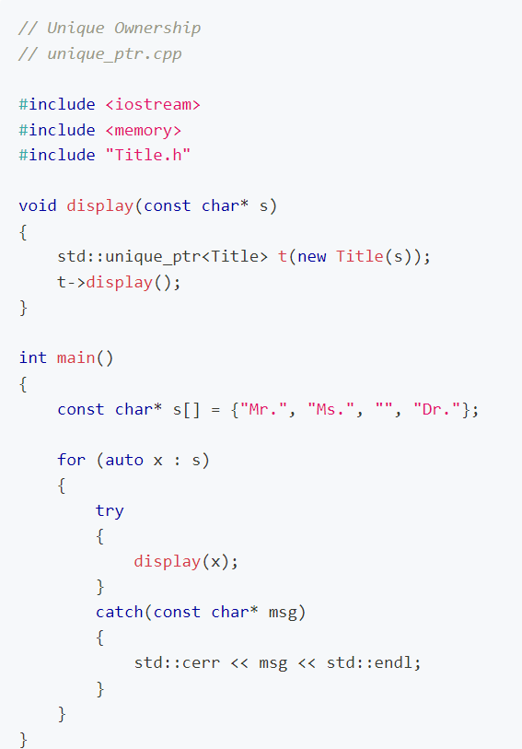
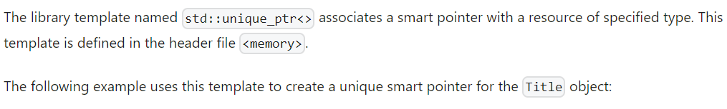
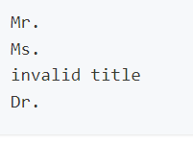

Slide 36
Shared Ownership
Several smart pointers can share the same object or resource. Managing such many-to-one relationships for an object or resource requires reference-counting. A reference counter keeps track of the number of smart pointers currently pointing to the same object or resource. Only if this counter is 1, does a shared smart pointer destroy the object or resource when the pointer goes out of scope.
A reference-counted smart pointer
stores a raw pointer to its object or resource
shares ownership of its object or resource with other smart pointers
transfers ownership of the resource in move construction and move assignment
copies itself in a copy construction
releases itself from its object or resource and reattaches itself in a copy assign
can be compared for equality
calls its object's or resource's destructor only if it itself is being destroyed and no other smart pointer shares ownership of the object or resource

Slide 37

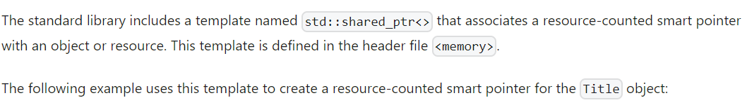
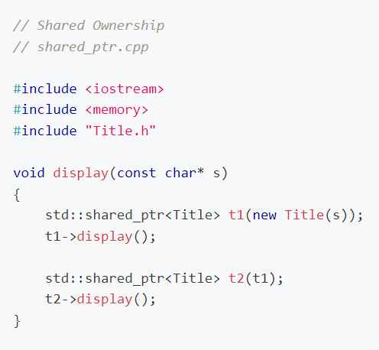
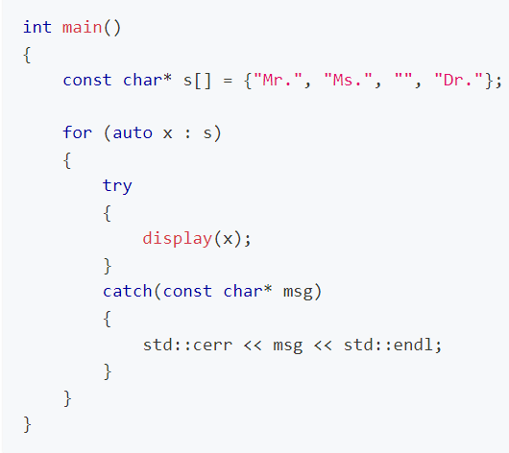
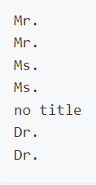

Slide 38
Exercises
Read Code Project on C++ Smart Pointers
Read informIT on Be Smart About C++ Pointers
Read Bjarne Stroustrup on unique_ptr
Read David Kieras on Using C++'s Smart Pointers
Read Bartosz Milewski on Strong Pointers and Resource Management in C++

